Slide 1


MALAKAND CAMPUS CHAKDARA KPK PAKISTAN

Slide 2
RIPHAH INTERNATIONAL UNIVERSITY
MALAKAND CAMPUS CHAKDARA KPK PAKISTAN

Slide 3
Lecture 12 & 13
Transistors
Bipolar Junction transistors(BJT) characteristics & parameters
MALAKAND CAMPUS CHAKDARA KPK PAKISTAN

Slide 4
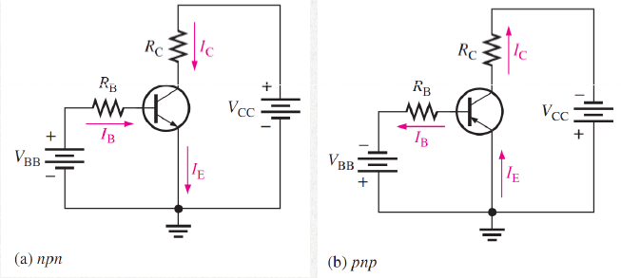
Transistor:
As discussed previously, when a transistor is connected to a dc bias voltages, VBB forward-biases the base-emitter junction, and VCC reverse-biases the base-collector junction.
IE= IC + IB

Slide 5

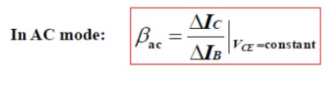
DC Beta (βDC) and DC Alpha (αDC)
Two important parameters are βDC and αDC are used to analyze a transistor circuit.
βDC : The dc current gain of a transistor is the ratio of the dc collector current (IC) to the dc base current (IB) and is designated dc beta (βDC).
Typical values of βDC range from less than 20 to 200 or higher.
This beta is known as
Current gain

Slide 6

DC Beta (βDC) and DC Alpha (αDC)
αDC : The ratio of the dc collector current (IC) to the dc emitter current (IE) is the dc alpha (αDC).
The alpha is a less-used parameter than beta in transistor circuits.
Typically, values of αDC range from 0.95 to 0.99 or greater, but αDC is
always less than 1.
The reason is that IC is always slightly less than IE by the amount of IB
(IE = IC + IB).

Slide 7
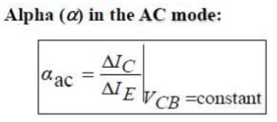
DC Beta (βDC) and DC Alpha (αDC)
Example 1:
If IE = 100 mA and IB = 1 mA,
As we know that IE = IB + IC
then
IC = IE – IB = 100 – 1 = 99 mA
therefore
αDC = IC / IE = 99 / 100 = 0.99.
βDC = IC / IB = 99 / 1 = 99.

Slide 8
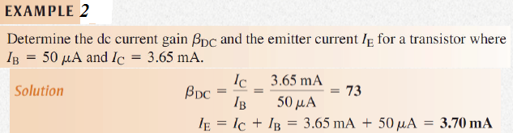
DC Beta (βDC) and DC Alpha (αDC)

Slide 9
Relationship between DC Beta (βDC) & DC Alpha (αDC)
A relationship can be developed between β and α using the basic equations of Beta and Alpha.
As βDC = IC / IB
So IB = IC / β → eq1
And from Alpha αDC = IC / IE
IE = IC / α→ eq2

Slide 10
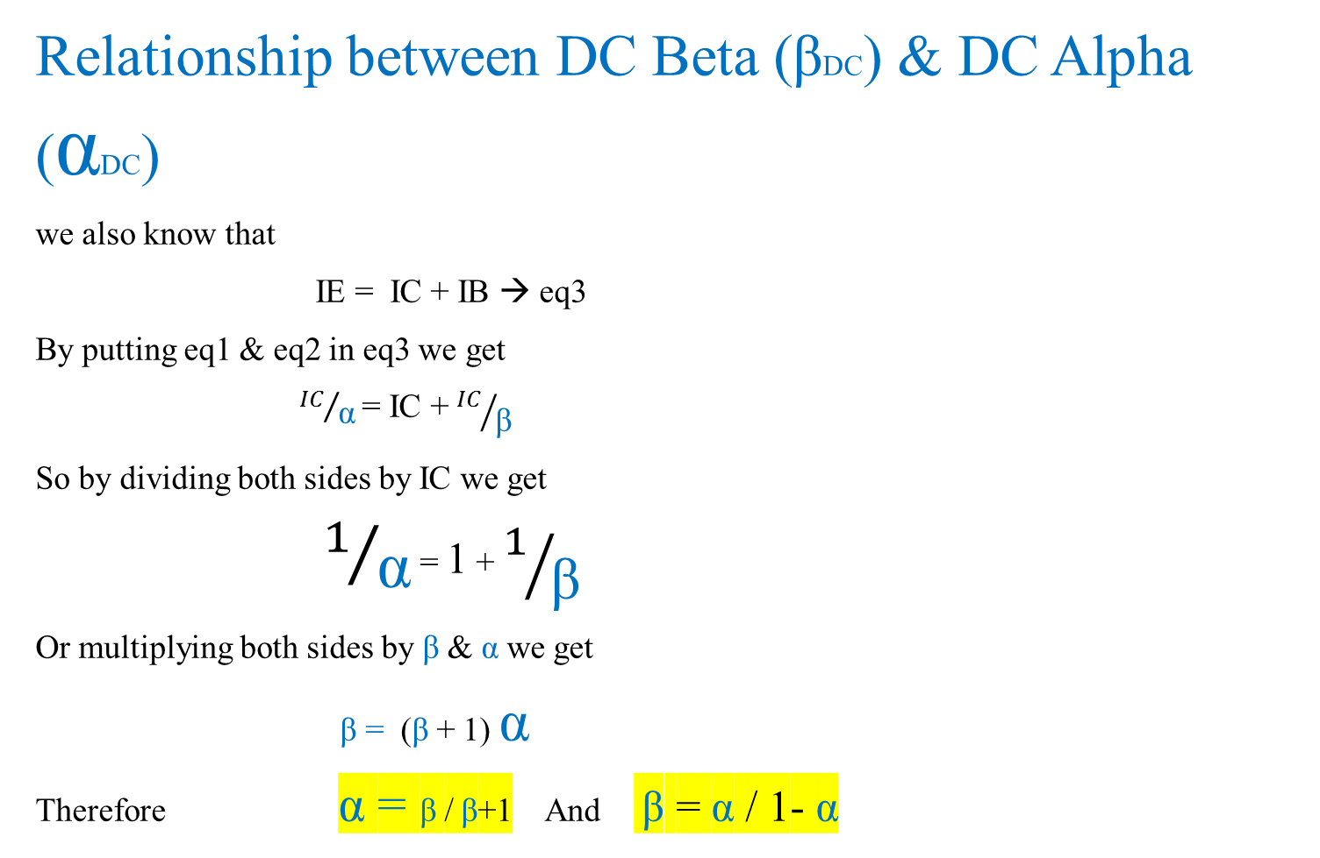
Relationship between DC Beta (βDC) & DC Alpha (αDC)
we also know that
IE = IC + IB → eq3
By putting eq1 & eq2 in eq3 we get
${IC}/{\text{α}}$ = IC + ${IC}/{\text{β}}$
So by dividing both sides by IC we get
$1/{\text{α}}$ = 1 + $1/{\text{β}}$
Or multiplying both sides by $\text{β}$ & $\text{α}$ we get
$\text{β}\text{ = }\text{(}\text{β}$ + 1) $\text{α}$
Therefore $\text{α}\text{ = }\text{β}$ / $\text{β}$+1 And $\text{β}$ = $\text{α}$ / 1- $\text{α}$

Slide 11
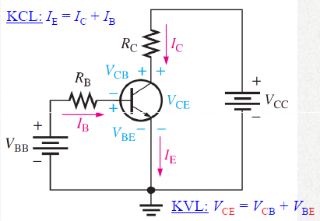
BJT Circuit Analysis (current & voltage):
W consider the basic transistor bias circuit configuration in below figure
Three transistor dc currents and three transistor dc voltages can be identified which are:

Slide 12
BJT Circuit Analysis (current & voltage):
IB: dc base current
IE: dc emitter current
IC: dc collector current
VBE: dc voltage at base with respect to emitter.
VCB: dc voltage at collector with respect to base.
VCE: dc voltage at collector with respect to emitter.
VBB forward-biases the BE junction, and VCC reverse-biases the BC junction. When BE is forward-biased, it is like a forward-biased diode and has a nominal forward voltage drop of ~0.7 V.
So VBE = 0.7 v

Slide 13
BJT Circuit Analysis (current & voltage):
Since the emitter is at ground state (0V)
So by Kirchhoff voltage law the voltage across
RB is
VRB = VBB – VBE
Also by Ohms Law VRB = IB RB
so IB RB = VBB – VBE
Therefore IB = VBB – VBE / RB

Slide 14
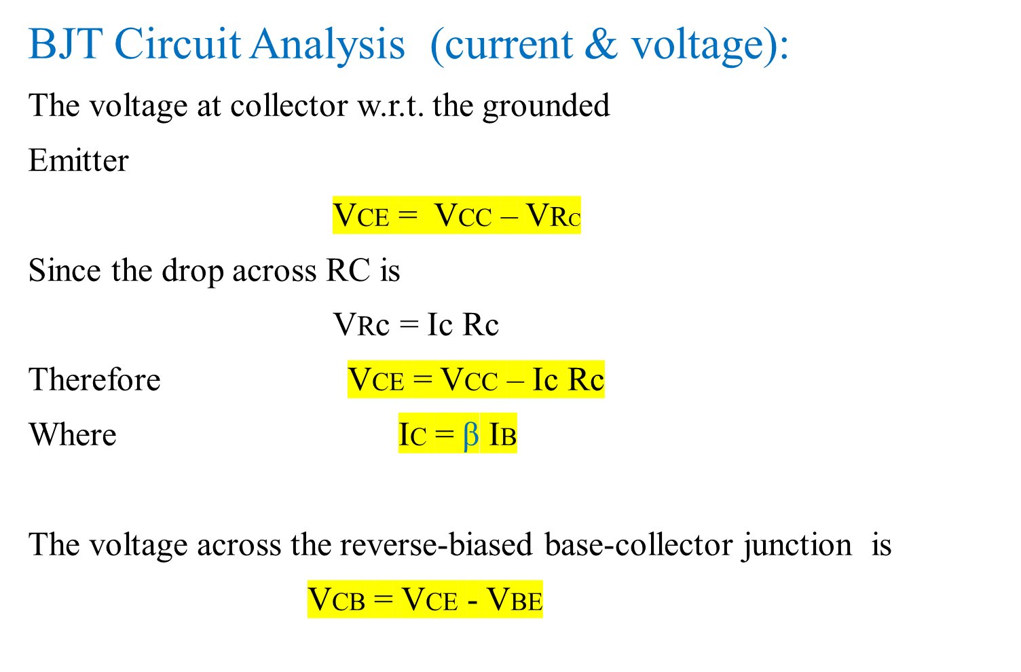
BJT Circuit Analysis (current & voltage):
The voltage at collector w.r.t. the grounded
Emitter
VCE = VCC – VRC
Since the drop across RC is
VRc = Ic Rc
Therefore VCE = VCC – Ic Rc
Where IC = $\text{β}$ IB
The voltage across the reverse-biased base-collector junction is
VCB = VCE - VBE

Slide 15
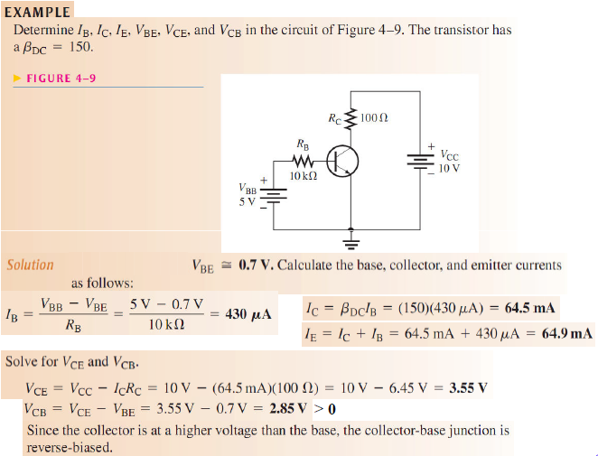
BJT Circuit Analysis (current & voltage):

Slide 16
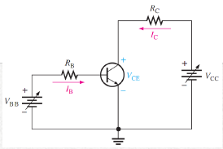
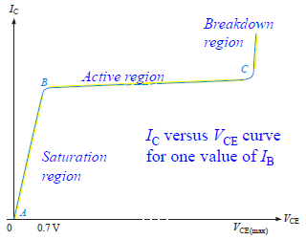
BJT Characteristics
The collector characteristic curves show the relationship
of the three transistor currents.
The curve shown is for a fixed base current.
The first region is the saturation region. As VCE
is increased, IC increases until B.
Then it flattens in the region between points B
and C, which is the active region. After C, is the
breakdown region.

Slide 17
BJT Characteristics
Consider point A on the characteristic curve:
Assume that VBB is set to produce a certain value of IB and VCC is zero.
• For this condition, both the BE junction and the BC junction are forward biased, because the base is at approximately 0.7 V while the emitter and the collector are at 0 V.
• IB is through the BE junction, because of the low impedance path to ground and, therefore, IC is zero.
When both junctions are forward-biased, the transistor is in the saturation region of its operation.

Slide 18
BJT Characteristics
Consider the portion of the curve between points A and B:
Saturation is the state of a BJT in which IC has reached a maximum and is independent of IB. IB is constant, but IC is increasing.
•When VCC is increased, VCE increases as IC increases.
• IC increases as VCC is increased because VCE remains less than 0.7 V due to the forward-biased BC junction.
VCE = VCB + VBE = negative + 0.7 < 0.7
and IC = (VCC – VCE) / RC

Slide 19
BJT Characteristics
Consider the portion of the curve between points B and C:
Ideally, when VCE exceeds 0.7 V, the BC junction becomes reverse-biased and the transistor goes into the active, or linear, region of its operation.
Once the BC junction is reverse-biased, IC levels off and remains essentially constant for a given value of IB as VCE continues to increase.
Actually, IC increases very slightly as VCE increases due to widening of the BC depletion region.
This results in fewer holes for recombination in the base region which effectively causes a slight increase in βDC.
For this portion of the characteristic curve, the value of IC is determined only by the relationship IC = βDC IB.

Slide 20
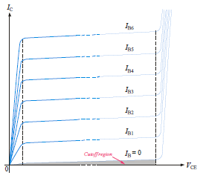

BJT Characteristics
Consider the portion of the curve to the right of point C:
When VCE reaches a sufficiently high voltage, the reverse-biased BC junction goes into breakdown; and IC increases rapidly.
A transistor should never be operated in this breakdown
region.
By setting up other values of base current, a family
of collector curves is developed.
βDC is the ratio of collector
current to base current.
It can be read from the curves. The value of βDC is nearly the
same wherever it is read.

Slide 21
BJT Characteristics
A family of collector characteristic curves is produced when IC versus VCE is plotted for several values of IB.
When IB = 0, the transistor is in the cutoff region although there is a very small collector leakage current.
Cutoff is the non-conducting state of a transistor.
The amount of collector leakage current for IB = 0 is exaggerated on the graph for illustration.

Slide 22
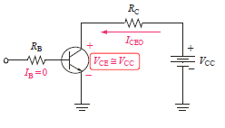
Cutoff :
In a BJT, cutoff is the condition in which there is no base
current (IB = 0), which results in only an extremely small
leakage current (ICEO ≈ 0) in the collector circuit (due mainly
to thermally produced carriers).
For practical work, this current is assumed to be zero.
In cutoff, neither the BE junction,
nor the BC junction are forward biased.
The subscript CEO represents
collector-to-emitter with the base
open.

Slide 23
Saturation :
When the BE junction becomes forward-biased and IB is
increased, IC also increases (IC = βDC IB), and VCE decreases as a result of more drop across RC,
VCE = VCC – IC RC.
When V reaches its saturation value, VCE(sat) the BC Junction becomes forward-biased and IC can increase no further, even with a continued increase in IB.
At the point of saturation, the relation IC = βDC IB is no longer valid.
VCE(sat) for a transistor occurs somewhere below the knee of the collector curves, and it is usually only a few tenths of a volt.

Slide 24
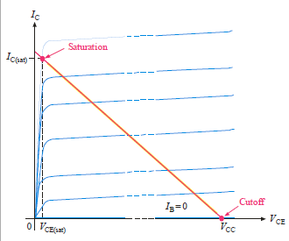
DC Load line :
When The DC load line represent the circuit that is external to transistor. It is drawn by connecting the saturation and cutoff points.
The transistor characteristic curves are shown superimposed on the load line. The region between the saturation and cutoff points is called the active region.

Slide 25


Thank You

